Slide 1
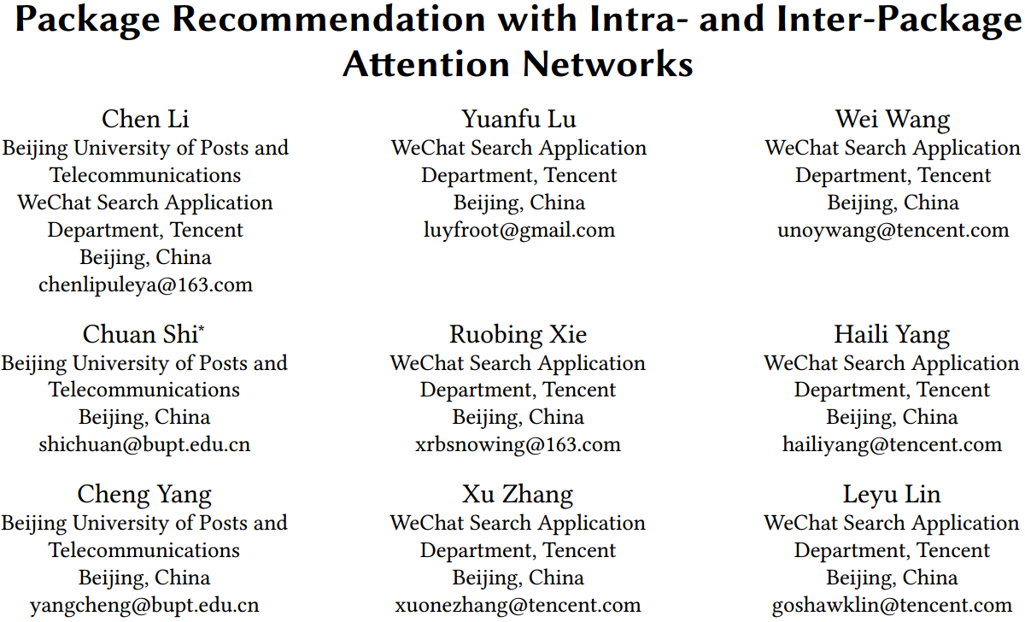

Slide 2
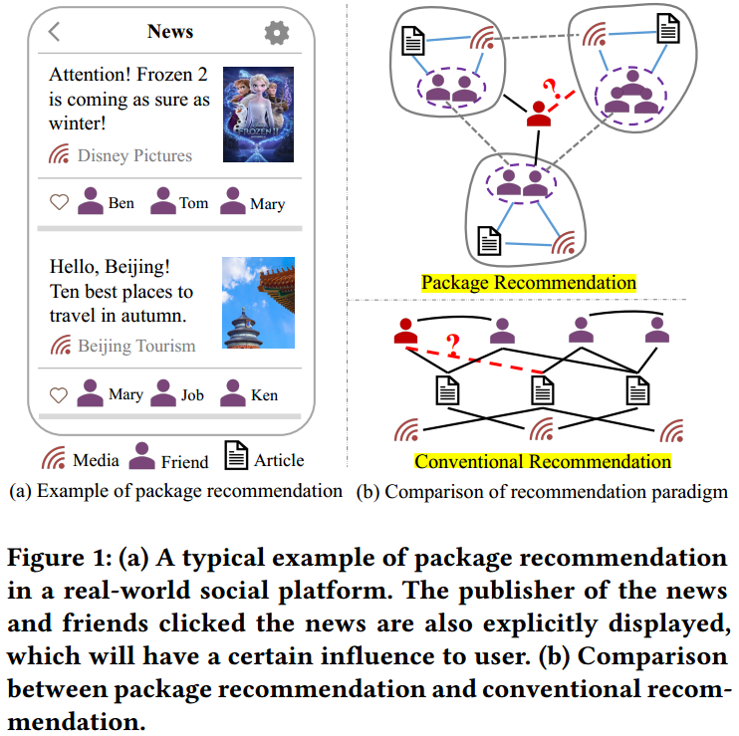
Motivation
Traditional recommendation scenario that only displays the candidate items to the user, in package recommendation, objects in the package (e.g., the publisher of the news and the friends who click the news) are explicitly shown to the user, which will highlight the inﬂuence of various objects on the user’s behaviors.

Slide 3
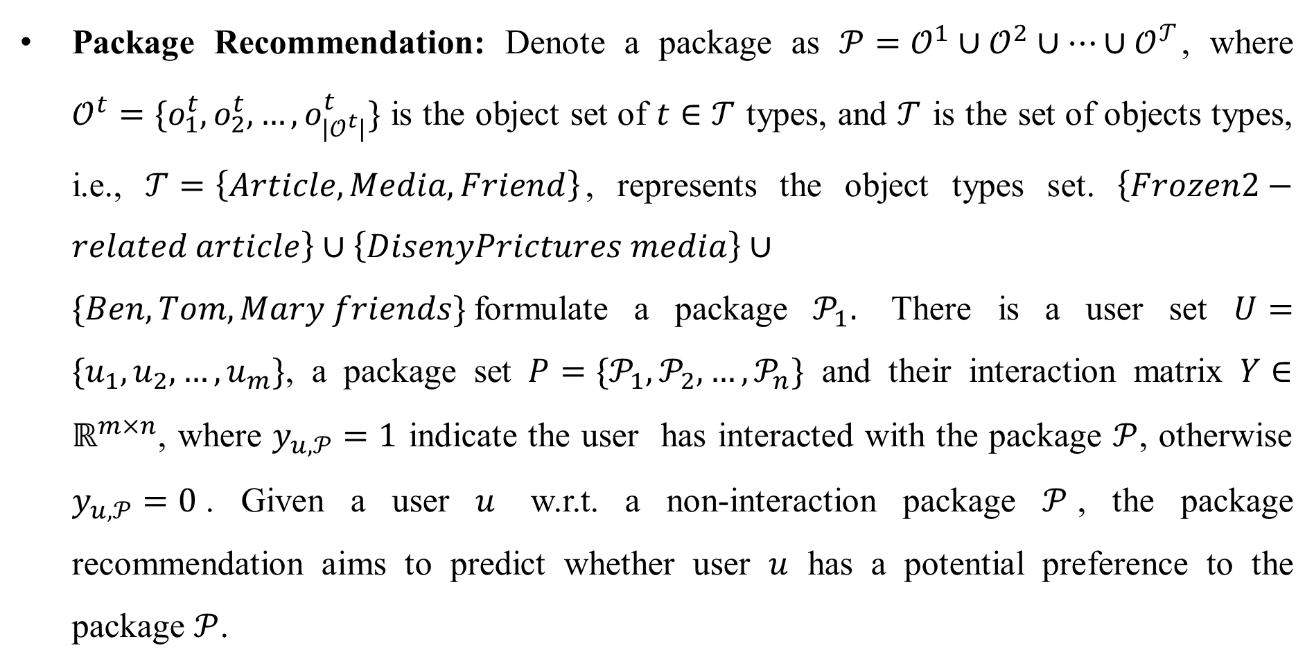
Problem Formulation
Package Recommendation: Denote a package as $𝒫=𝒪^{1}∪𝒪^{2}∪…∪𝒪^{𝒯}$, where $𝒪^{t}=\{o_{1}^{t},o_{2}^{t},…,o_{|𝒪^{t}|}^{t}\}$ is the object set of $t∈𝒯$ types, and $𝒯$ is the set of objects types, i.e., $𝒯=\left\{Article, Media, Friend\right\}$, represents the object types set. $\left\{Frozen2−related article\right\}∪\left\{DisenyPrictures media\right\}∪\{Ben, Tom, Mary friends\}$formulate a package $𝒫_{1}.$ There is a user set $U=\{u_{1},u_{2},…,u_{m}\}$, a package set $P=\{𝒫_{1},𝒫_{2},…,𝒫_{n}\}$ and their interaction matrix $Y∈ℝ^{m×n}$, where $y_{u,𝒫}=1$ indicate the user has interacted with the package $𝒫$, otherwise $y_{u,𝒫}=0$. Given a user $u$ w.r.t. a non-interaction package $𝒫$, the package recommendation aims to predict whether user $u$ has a potential preference to the package $𝒫$.

Slide 4
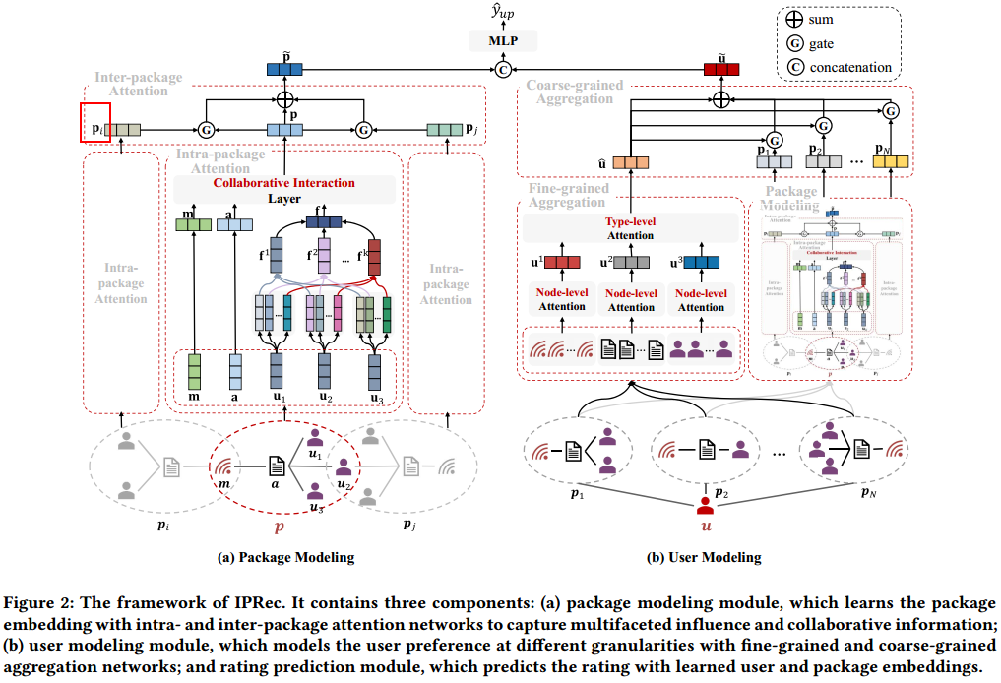
Package Recommendation (IPRec)

Slide 5
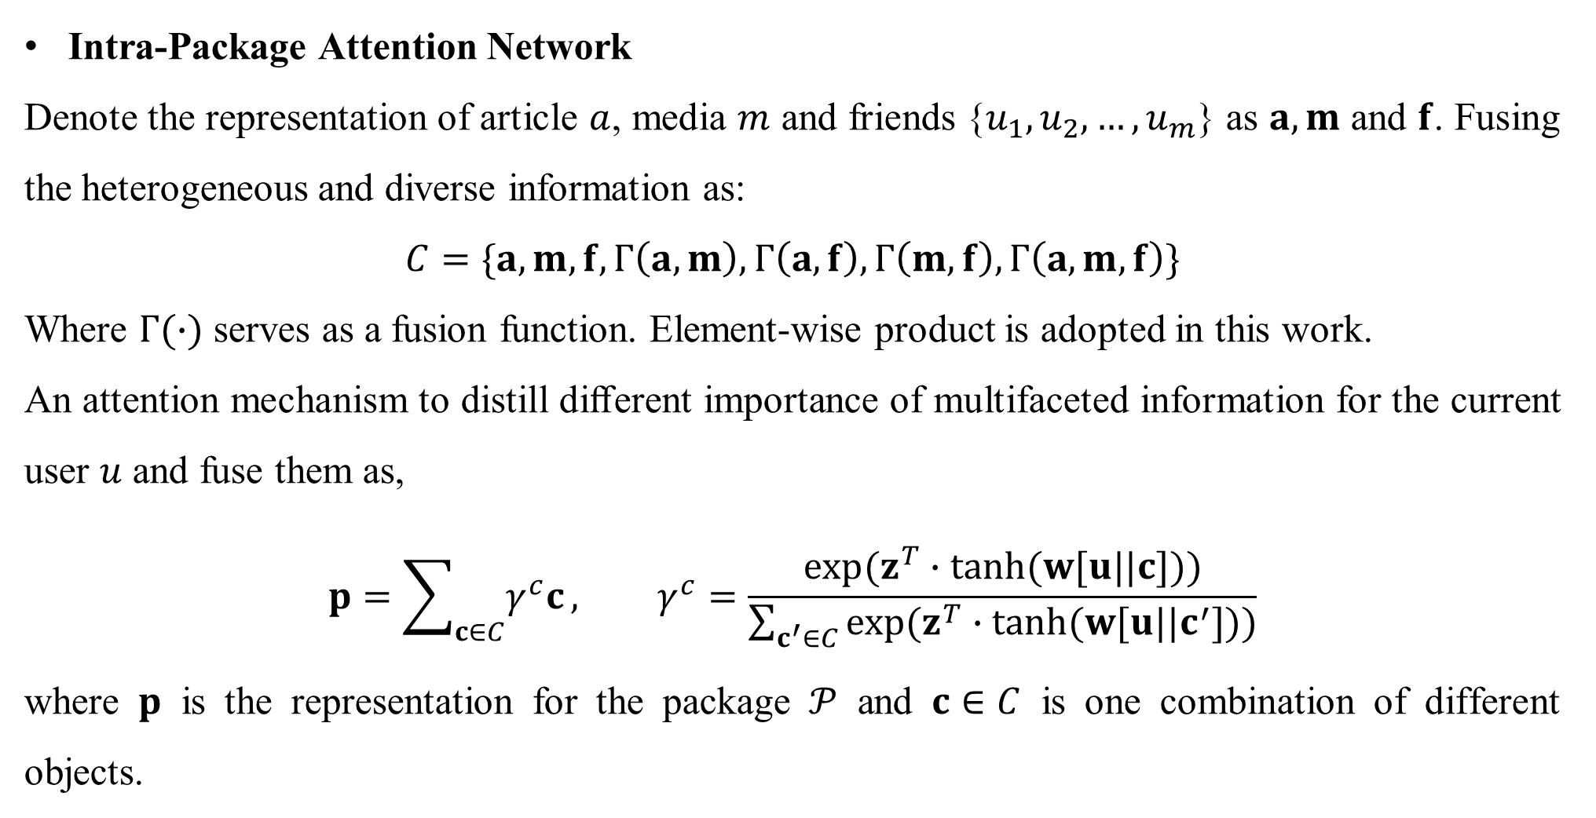
Package Modeling
Intra-Package Attention Network
Denote the representation of article $a$, media $m$ and friends {$u_{1},u_{2},…,u_{m}$} as $a, m$ and $f$. Fusing the heterogeneous and diverse information as:
$$C=\{a, m, f,Γ\left(a, m\right),Γ\left(a, f\right),Γ\left(m,f\right),Γ\left(a, m,f\right)\}$$
Where $Γ(∙)$ serves as a fusion function. Element-wise product is adopted in this work.
An attention mechanism to distill diﬀerent importance of multifaceted information for the current user $u$ and fuse them as,
$$p=\sum_{c∈C}{γ^{c}c}, γ^{c}=\frac{exp(z^{T}∙tanh(w[u||c]))}{\sum_{c^{′}∈C}{exp(z^{T}∙tanh(w[u||c^{′}]))}}$$
where $p$ is the representation for the package $𝒫$ and $c∈C$ is one combination of different objects.

Slide 6
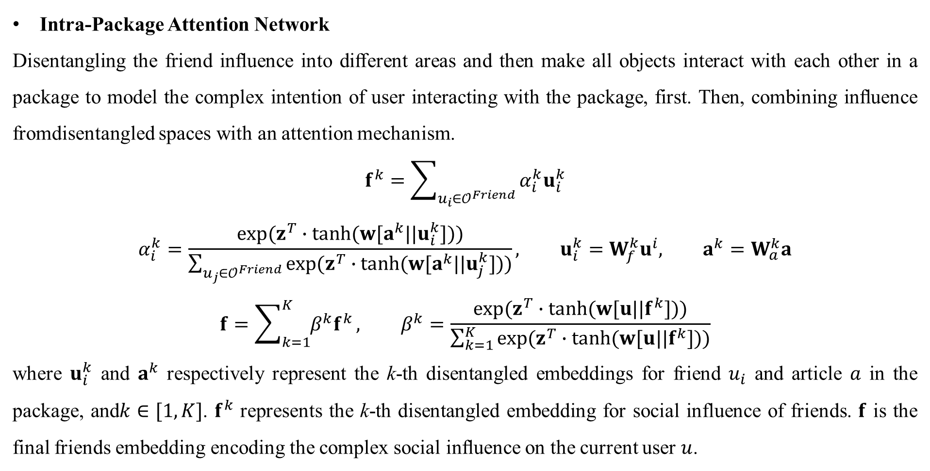
Package Modeling
Intra-Package Attention Network
Disentangling the friend inﬂuence into diﬀerent areas and then make all objects interact with each other in a package to model the complex intention of user interacting with the package, first. Then, combining inﬂuence fromdisentangled spaces with an attention mechanism.
$$f^{k}=\sum_{u_{i}∈𝒪^{Friend}}{α_{i}^{k}u_{i}^{k}}$$
$$α_{i}^{k}=\frac{exp(z^{T}∙tanh(w[a^{k}||u_{i}^{k}]))}{\sum_{u_{j}∈𝒪^{Friend}}{exp(z^{T}∙tanh(w[a^{k}||u_{j}^{k}]))}}, u_{i}^{k}=W_{f}^{k}u^{i}, a^{k}=W_{a}^{k}a$$
$$f=\sum_{k=1}^{K}{{β^{k}f}^{k}}, β^{k}=\frac{exp(z^{T}∙tanh(w[u||f^{k}]))}{\sum_{k=1}^{K}{exp(z^{T}∙tanh(w[u||f^{k}]))}}$$
where $u_{i}^{k}$ and $a^{k}$ respectively represent the k-th disentangled embeddings for friend $u_{i}$ and article $a$ in the package, and$k∈[1,K]$. $f^{k}$ represents the k-th disentangled embedding for social influence of friends. $f$ is the final friends embedding encoding the complex social inﬂuence on the current user $u$.

Slide 7
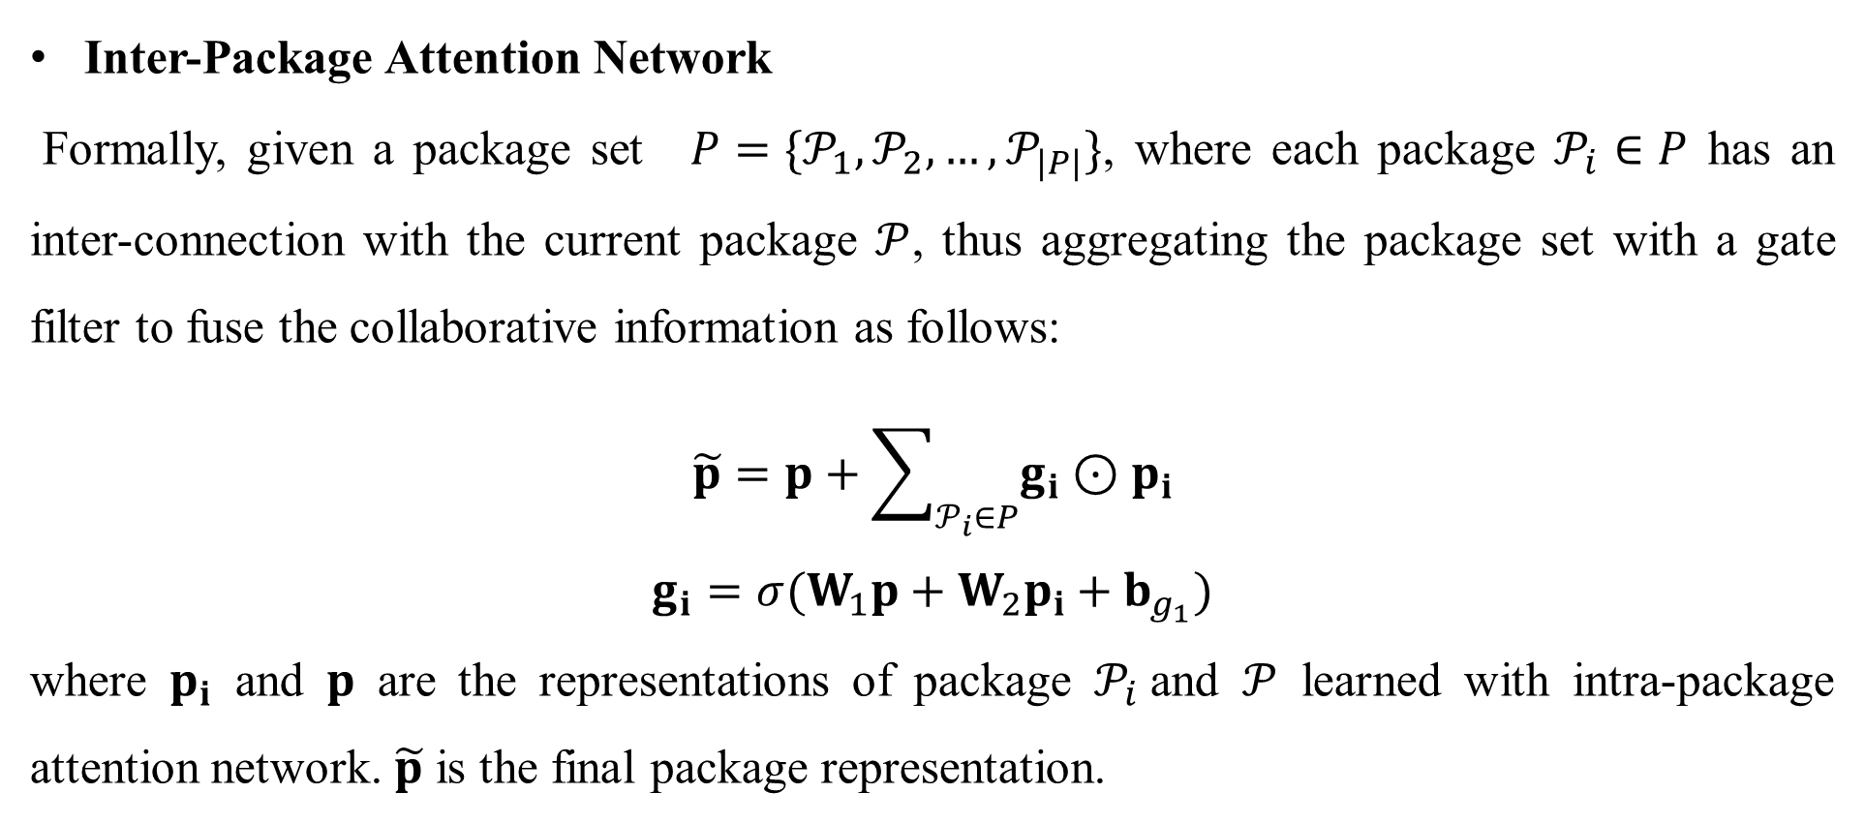
Package Modeling
Inter-Package Attention Network
Formally, given a package set $P=\{𝒫_{1},𝒫_{2},…,𝒫_{|P|}\}$, where each package $𝒫_{i}∈P$ has an inter-connection with the current package $𝒫$, thus aggregating the package set with a gate filter to fuse the collaborative information as follows:
$$\tilde{p}=p+\sum_{𝒫_{i}∈P}{g_{i}⊙p_{i}}$$
$$g_{i}=σ(W_{1}p+W_{2}p_{i}+b_{g_{1}})$$
where $p_{i}$ and $p$ are the representations of package $𝒫_{i}$and $𝒫$ learned with intra-package attention network. $\tilde{p}$ is the final package representation.

Slide 8
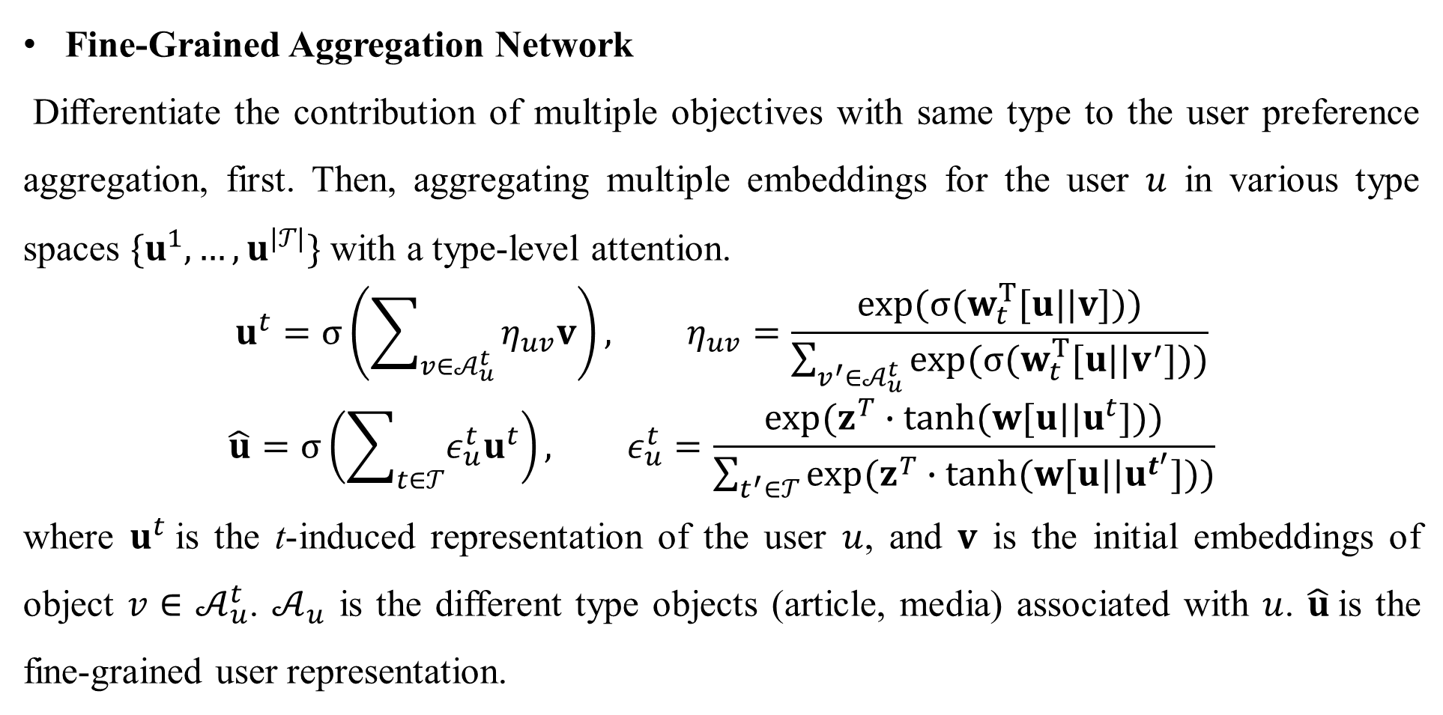
User Modeling
Fine-Grained Aggregation Network
Diﬀerentiate the contribution of multiple objectives with same type to the user preference aggregation, first. Then, aggregating multiple embeddings for the user $u$ in various type spaces $\{u^{1},…,u^{|𝒯|}\}$ with a type-level attention.
$$u^{t}=σ\left(\sum_{v∈𝒜_{u}^{t}}{η_{uv}v}\right), η_{uv}=\frac{exp(σ(w_{t}^{T}[u||v]))}{\sum_{v^{′}∈𝒜_{u}^{t}}{exp(σ(w_{t}^{T}[u||v^{′}]))}}$$
$$\hat{u}=σ\left(\sum_{t∈𝒯}{ε_{u}^{t}u^{t}}\right), ε_{u}^{t}=\frac{exp(z^{T}∙tanh(w[u||u^{t}]))}{\sum_{t^{′}∈𝒯}{exp(z^{T}∙tanh(w[u||u^{t^{′}}]))}}$$
where $u^{t}$is the t-induced representation of the user $u$, and $v$ is the initial embeddings of object $v∈$ $𝒜_{u}^{t}$. $𝒜_{u}$ is the different type objects (article, media) associated with $u$. $\hat{u}$is the fine-grained user representation.

Slide 9
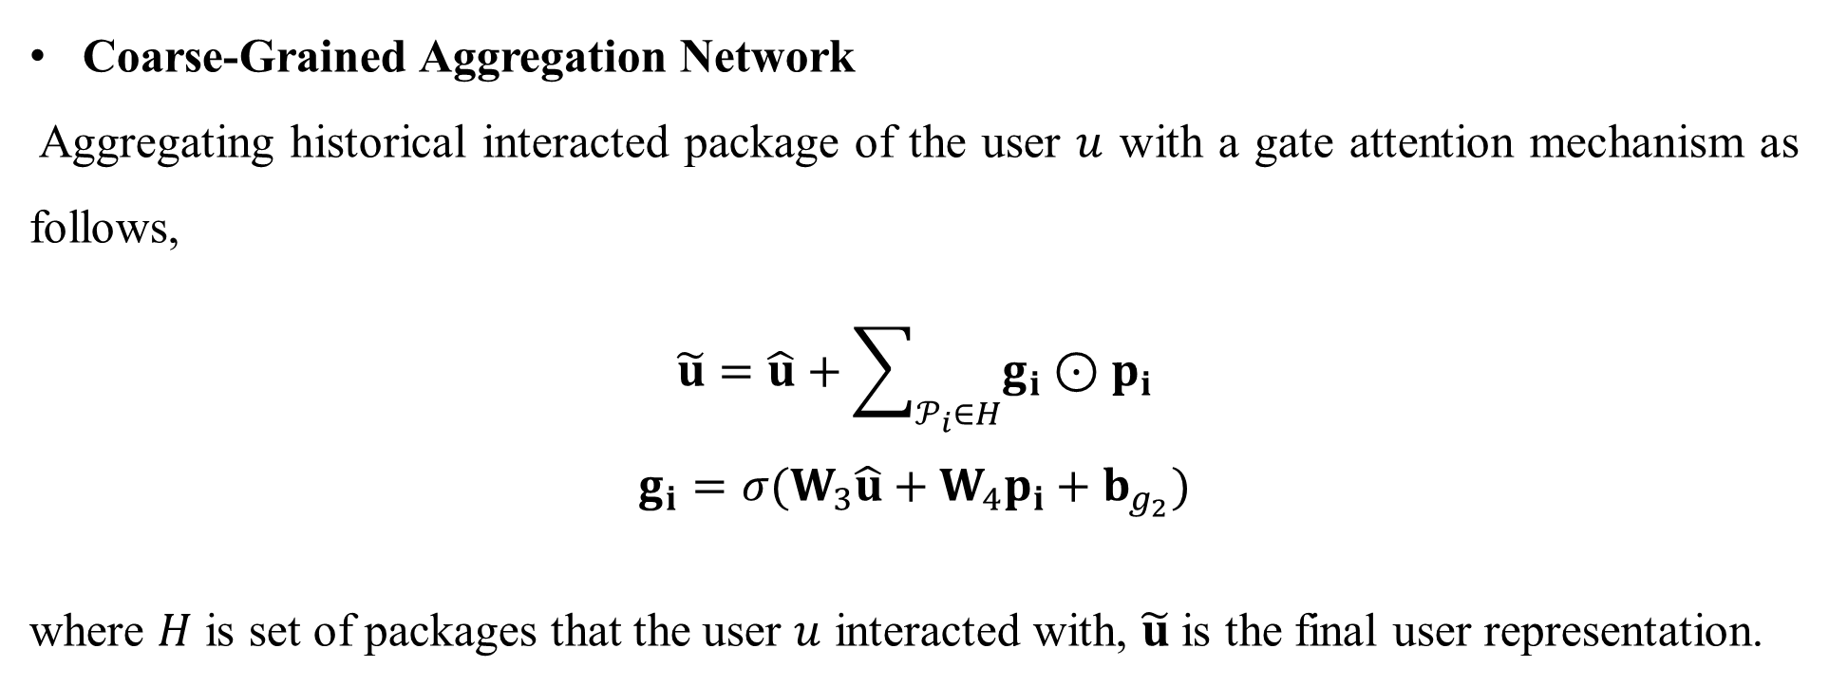
User Modeling
Coarse-Grained Aggregation Network
Aggregating historical interacted package of the user $u$ with a gate attention mechanism as follows,
$$\tilde{u}=\hat{u}+\sum_{𝒫_{i}∈H}{g_{i}⊙p_{i}}$$
$$g_{i}=σ(W_{3}\hat{u}+W_{4}p_{i}+b_{g_{2}})$$
where $H$ is set of packages that the user $u$ interacted with, $\tilde{u}$ is the final user representation.

Slide 10
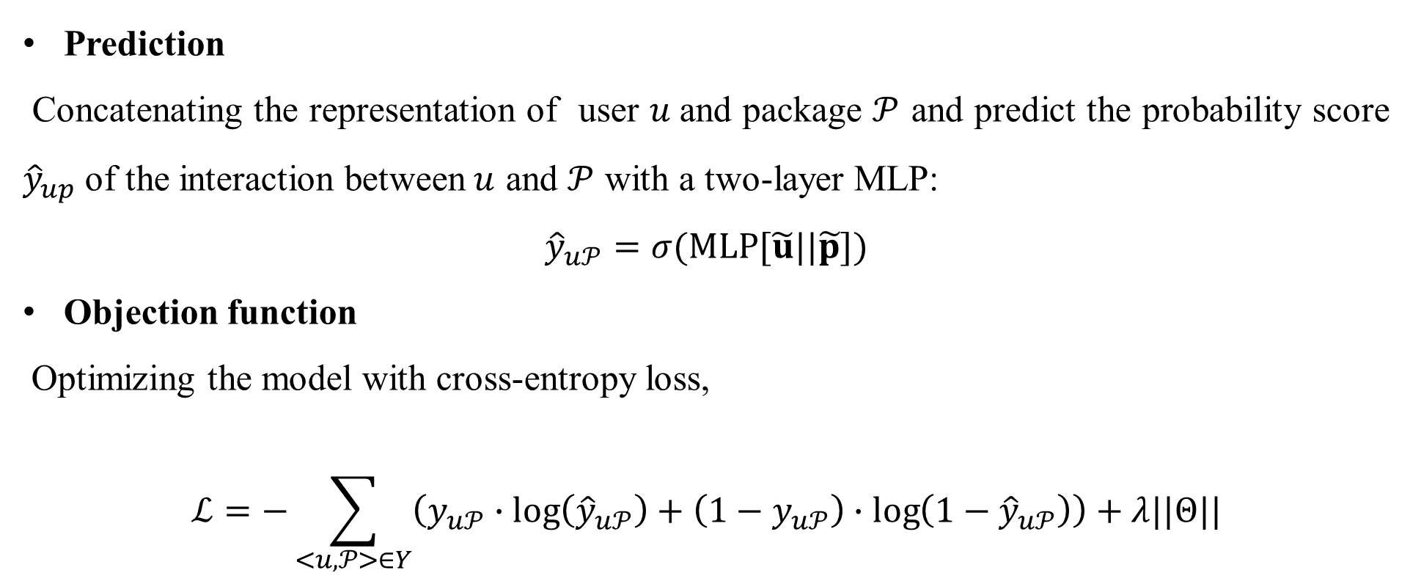
Prediction and Optimization
Prediction
Concatenating the representation of user $u$and package $𝒫$ and predict the probability score ${\hat{y}}_{up}$ of the interaction between$u$ and $𝒫$ with a two-layer MLP:
$${\hat{y}}_{u𝒫}=σ(MLP[\tilde{u}||\tilde{p}])$$
Objection function
Optimizing the model with cross-entropy loss,
$$ℒ=−\sum_{<u,𝒫>∈Y}{\left(y_{u𝒫}∙\log\left({\hat{y}}_{u𝒫}\right)+\left(1−y_{u𝒫}\right)∙\log\left(1−{\hat{y}}_{u𝒫}\right)\right)}+λ||Θ||$$

Slide 11
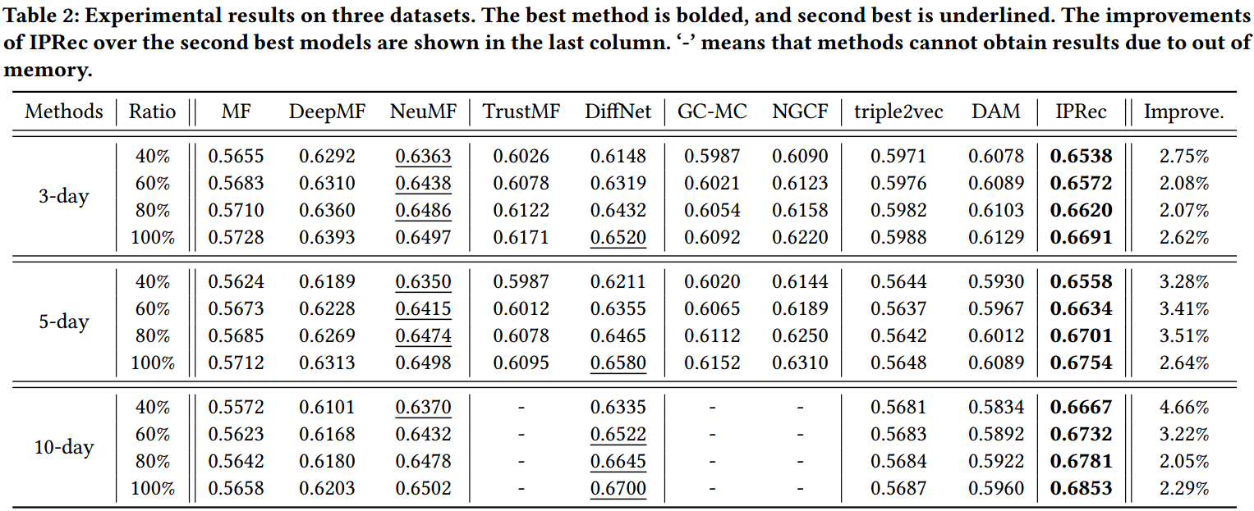
Experiments

Slide 12
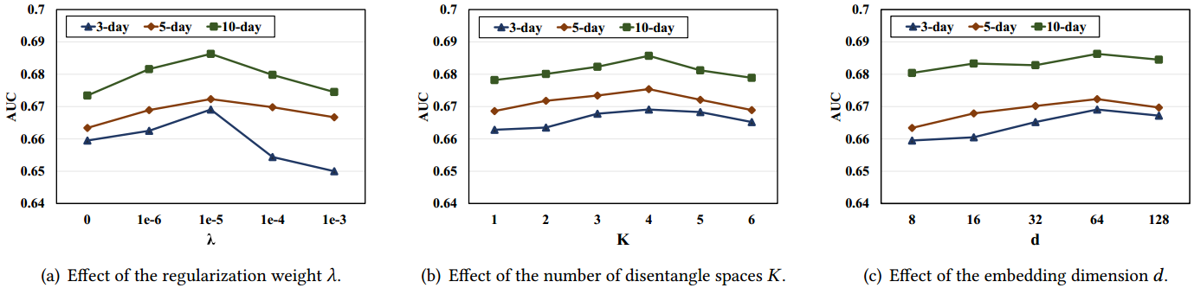
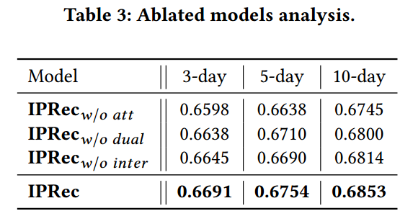
Experiments

